Slide 1
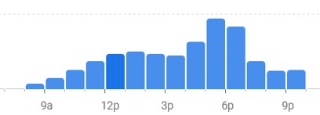
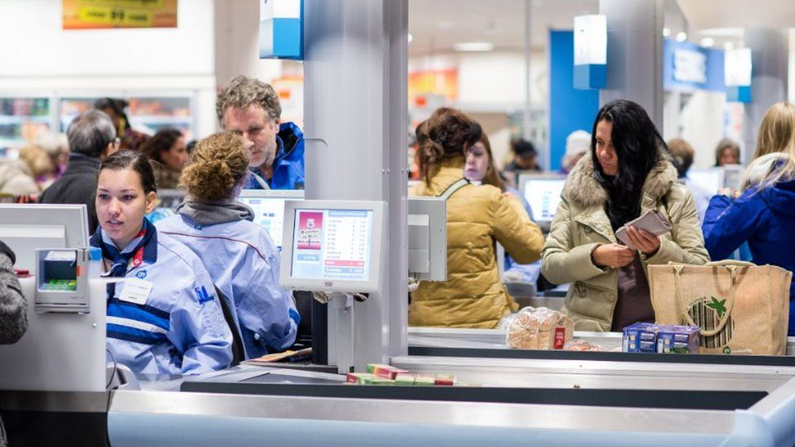

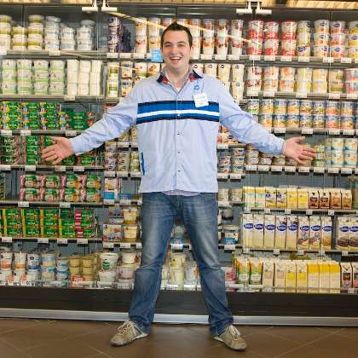
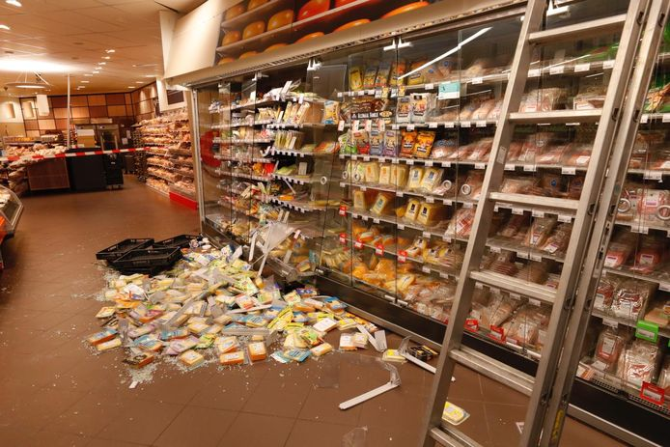
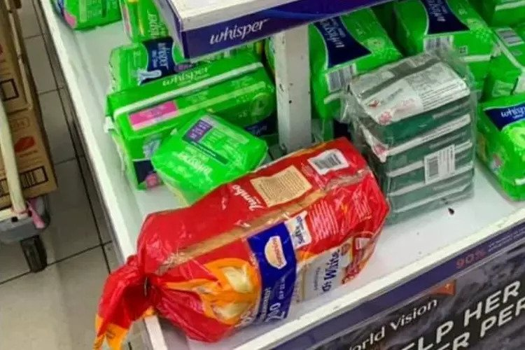
Source: Google Maps
Source: bbc.com
Source: plusonline.nl
Source: glassdoor.nl
Source: ed.nl
Source: mustsharenews.com
Notes:
Imagine it's your first week working at Albert Heijn --> Friday afternoon comes. --> things start to turn sideways. --> products left at the checkout --> on your way there you notice some fallen and misplaced products, --> lady asks you to get her an item from the top of a shelf. A lot of things happening …

Slide 2

Source: supermarketnews.com
Notes:
And of course stress and overwhelm build up.

Slide 3
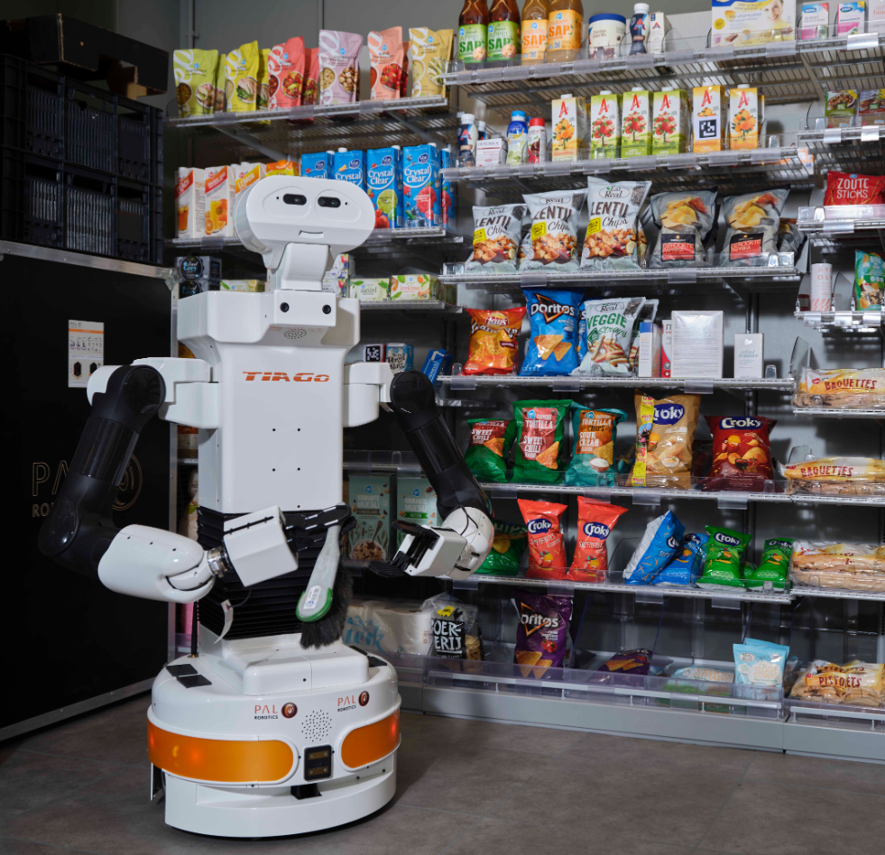

Ahold Delhaize Case: relocating products left at checkout
Group 10: - Rubén Martín Rodríguez (5507391) - Max Polak (4570677) - Pim de Ruijter (4580699) - Frankie Yuezhe Zhang (5390664) - Gioele Buriani (5629888)
Notes:
We are group 10 and we are going to present a first step towards putting a solution to this problem.

Slide 4
"Ahold Delhaize (problem owner)​ needs a way to free their employees from time-consuming undesirable tasks (problem)​ during periods of maximum customer flow (context) in order to increase employees' performance​ and customer service (goal)"​
PROBLEM STATEMENT
Notes:
Just to make it clear, our client, Ahold Delhaize, needs to find a way to free their employees for these unpleasant tasks during periods of high customer flow.

Slide 5


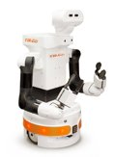
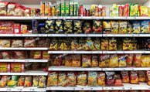
OUR SOLUTION
Make TIAGo return products left at the cashier to their original shelf​​
Notes:
enable TIAGo to relocate products at the checkout --> simple task, but which requires most of the components

Slide 6
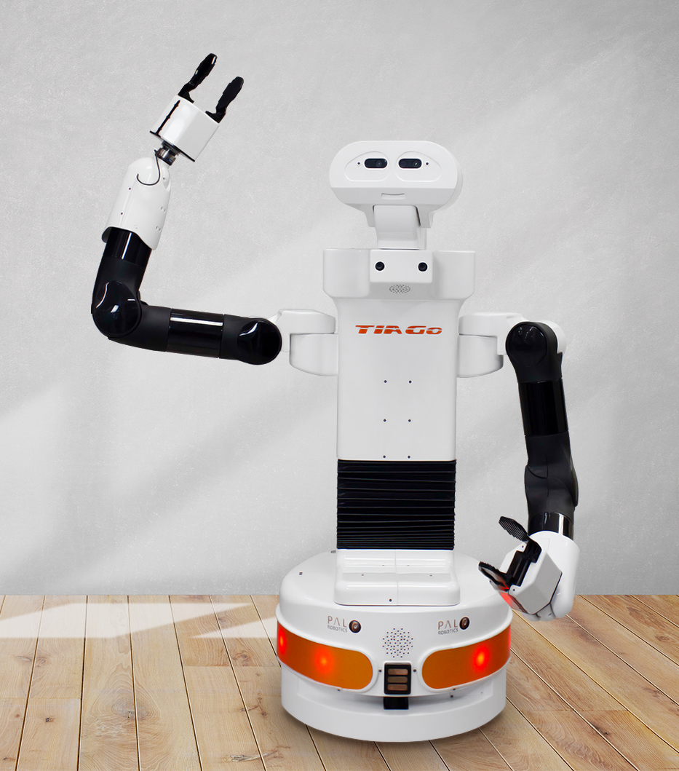
STRUCTURE
GUI
Navigation
Error handling
Perception
Planning
Motion control
Notes:
We will show how we achieved this by inspecting the different components and functionalities of our system, which can be seen on screen right now.

Slide 7
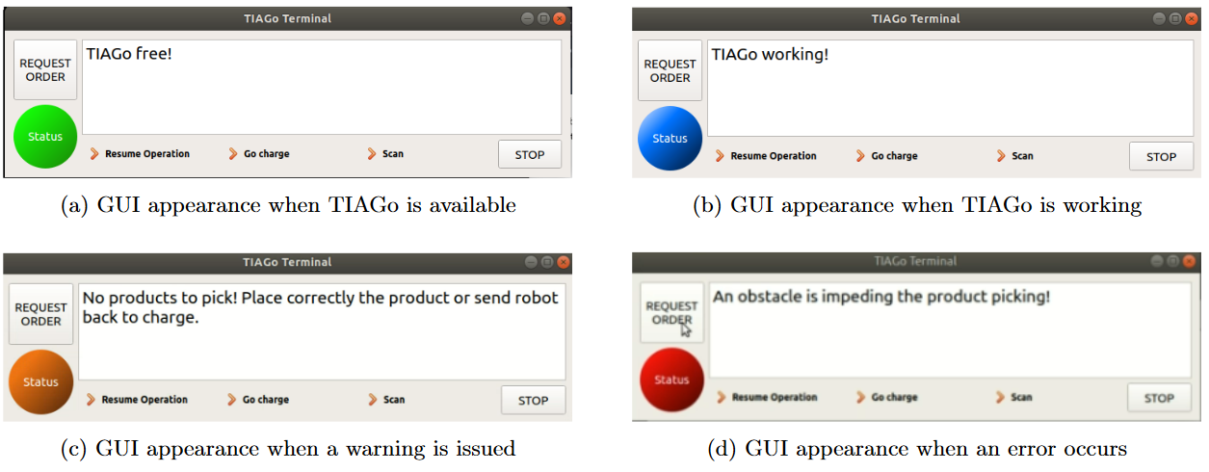
GUI
order_req
charge
server
Qt interface implemented in C++
Communication with system through dynamic reconfigure node
Level
scan
/params
Other nodes
GUI
Notes:
First of all, we need our robot to communicate with employees,
developed a GUI using Qt, intuitive buttons , indicator and panel for informing
integrates with the system by acting as a node, communicates reconfigurable node.

Slide 8
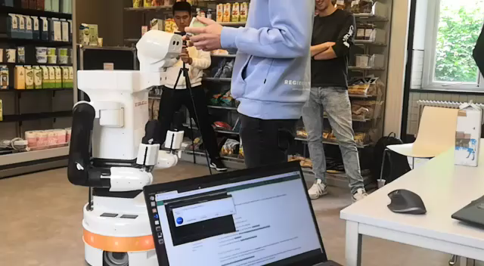
GUI
Notes:
displaying the "working" status and message back to the charging station.
Once it stops, the status changes to "free"
upon a click, it starts operation, "working" status in blue.

Slide 9
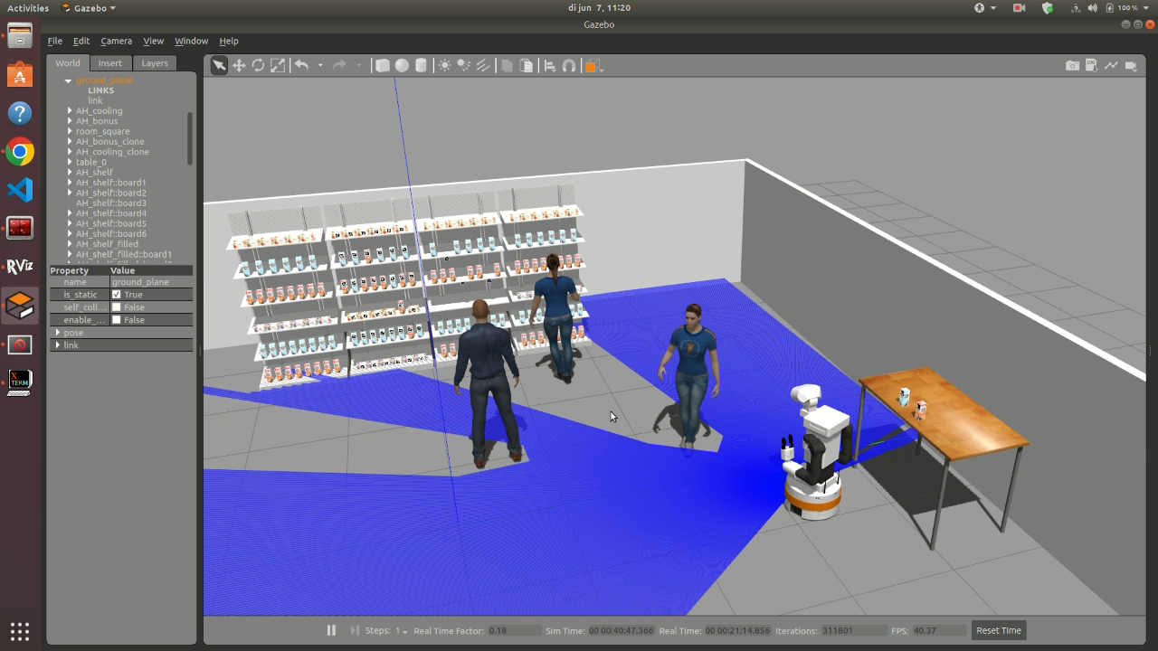
NAVIGATION
Autonomous navigation:
Using gmapping for map building (SLAM)
Using amcl for self-localization (MCL)
Local obstacle avoidance
Perform sequential actions when pressing buttons.
Error handling

Slide 10
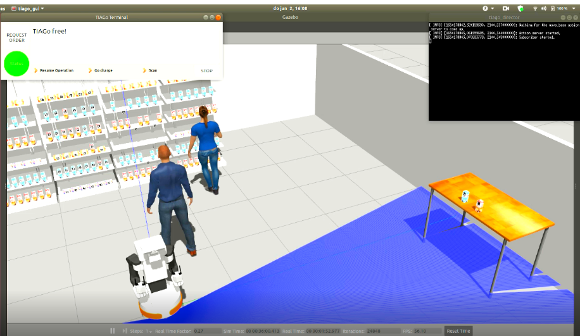
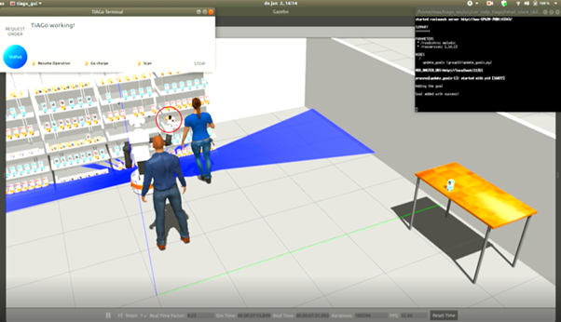
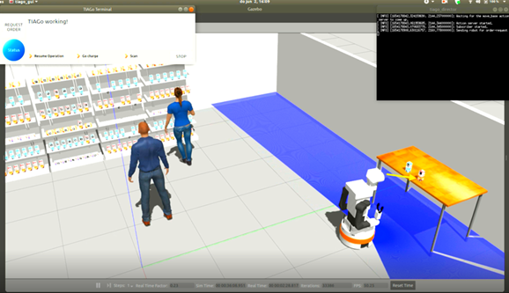
NAVIGATION
Charging station
Shelves
Checkout

Slide 11
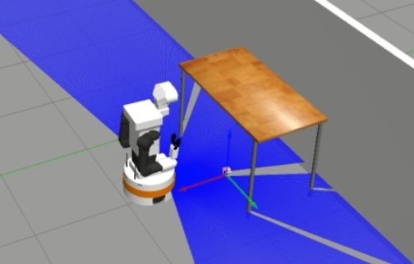
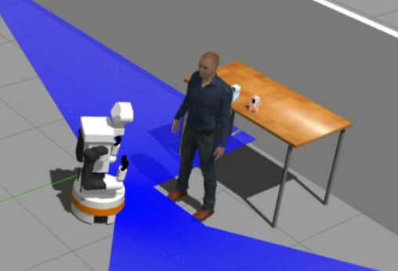
ERROR HANDLING
No products?
Obstruction?
?

Slide 12
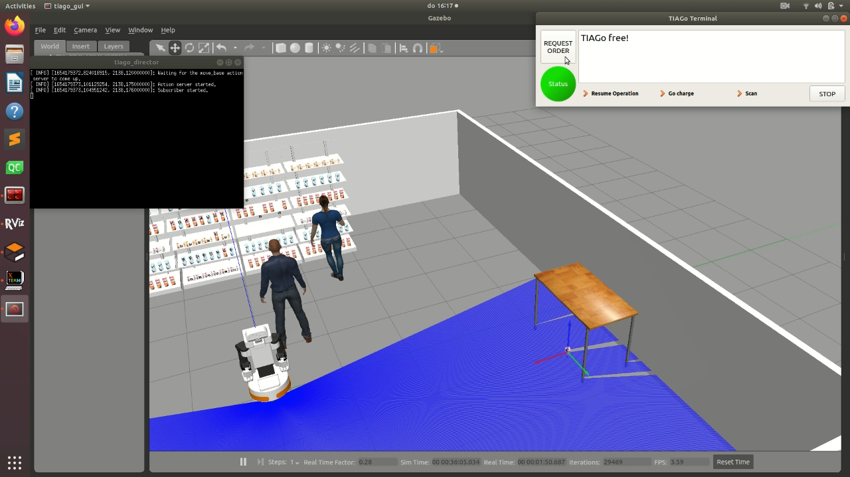
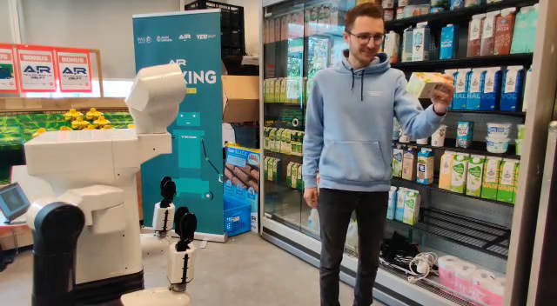
ERROR HANDLING
text-to-speech!

Slide 13
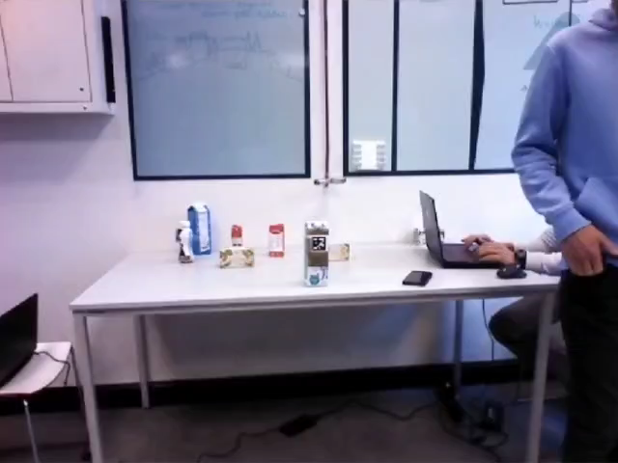
PERCEPTION
ArUco Tags
Works well on close range
Fewer false positives
Parameter server
Send highest priority item

Slide 14
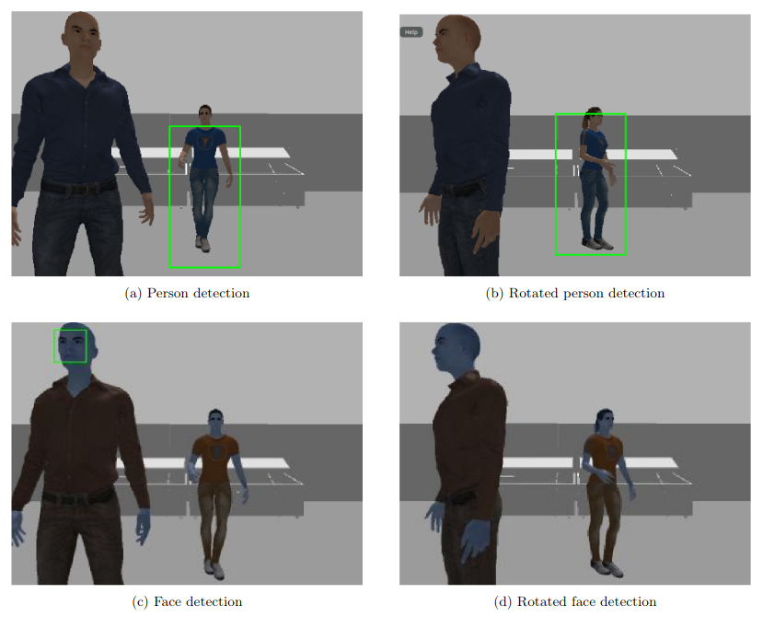
PERCEPTION
For proper human-robot interaction
Problems at close range
Problems when rotated

Slide 15
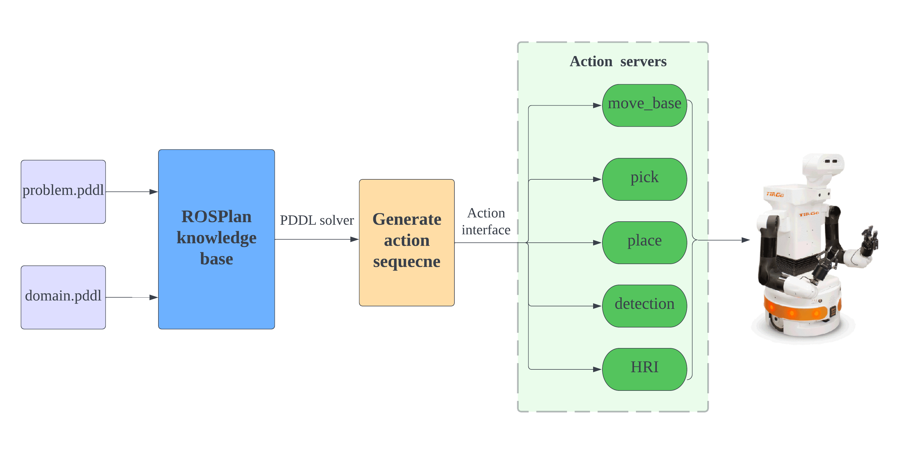
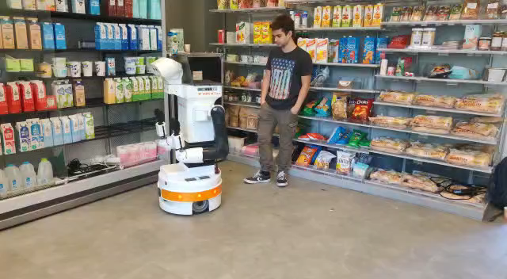
PLANNING – General PDDL
Construct the knowledge base only based on prior knowledge of the environment
Unable to deal with unseen environment or online request

Slide 16
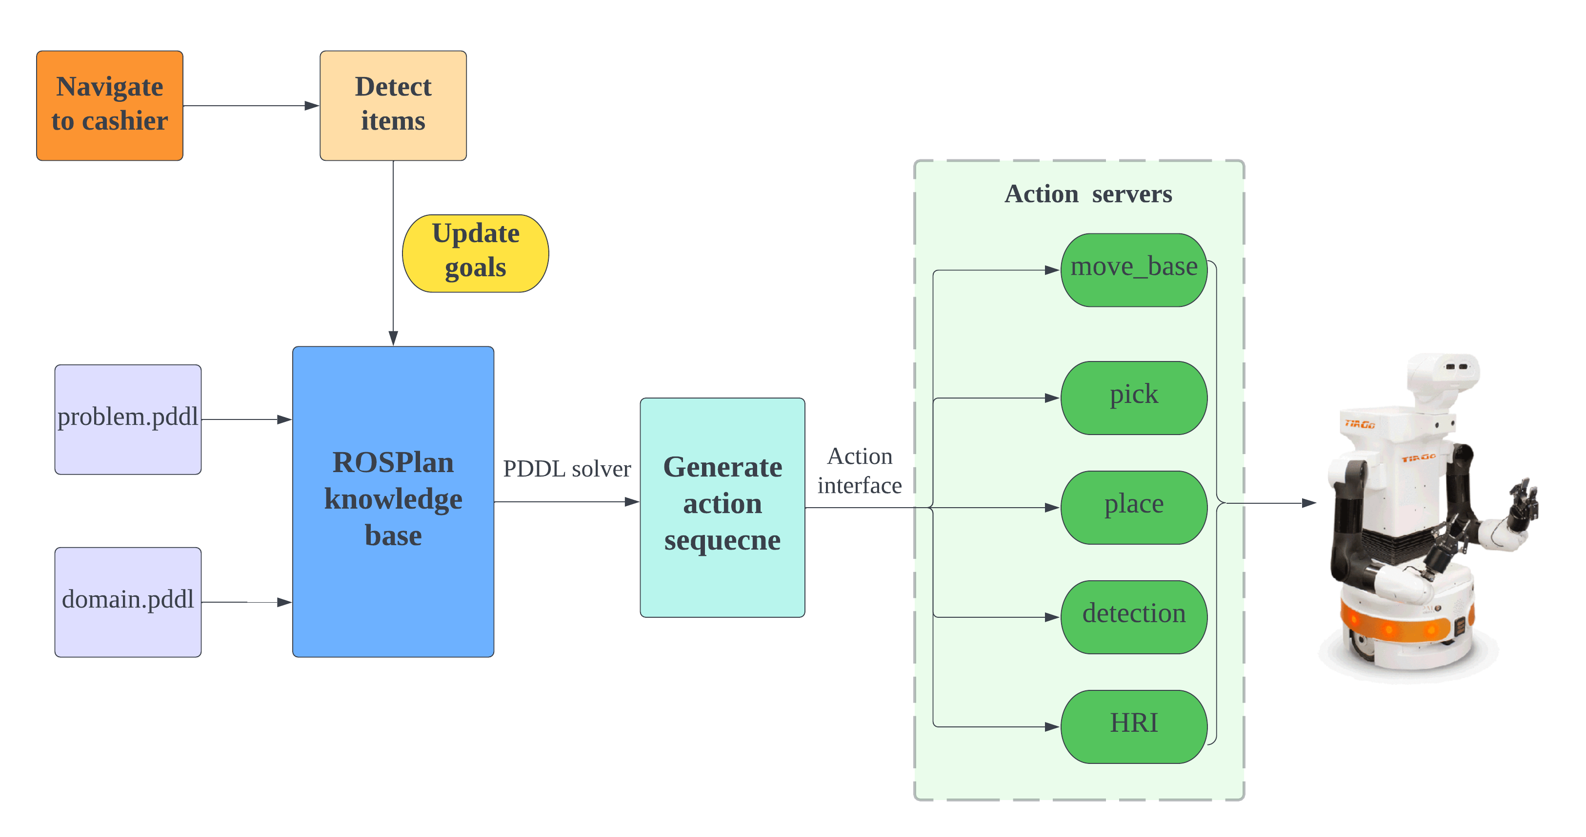
PLANNING – PDDL + update_goals
To address this issue, the update_goals node is used
To receive detected information after navigation, and integrate with the knowledge base

Slide 17
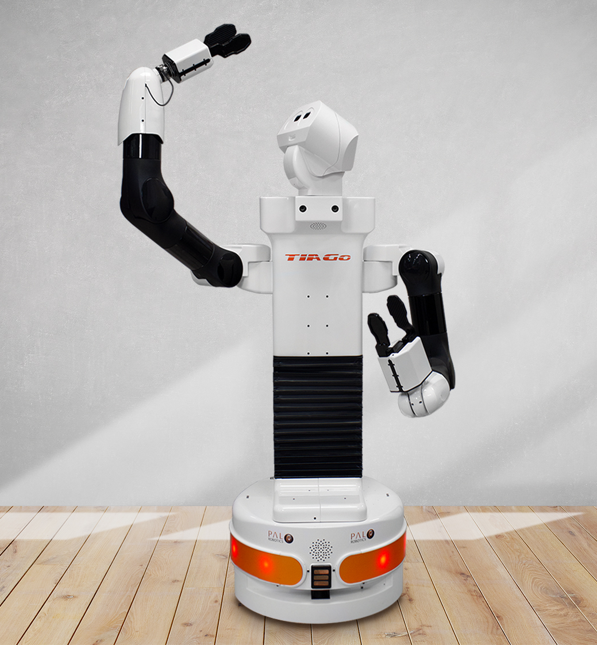
MOTION CONTROL
Basic actions:
Gripper control
Look to point
Move base
Complex actions:
Pick
Place

Slide 18
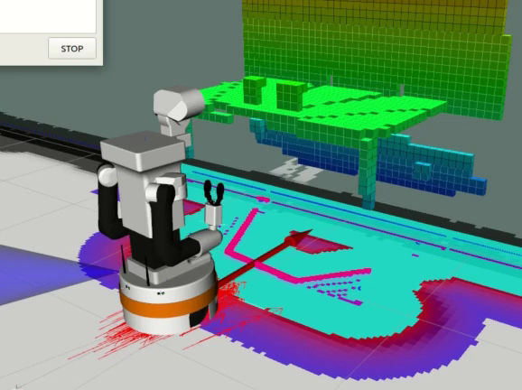
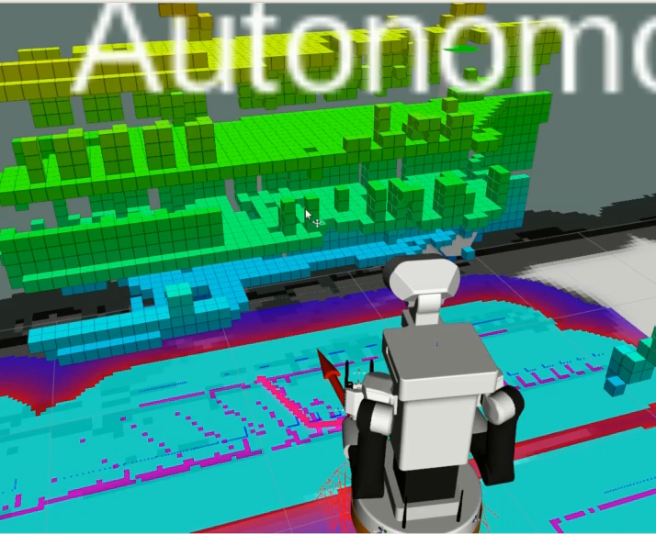
MOTION CONTROL

Slide 19
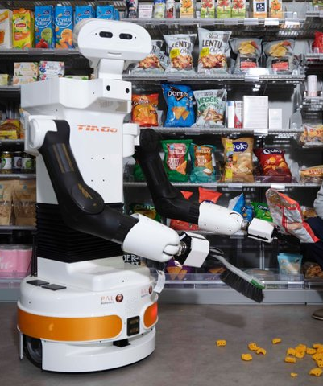
TO SUM UP
GUI
Navigation
Error handling
Perception
Planning
Motion control

Slide 20
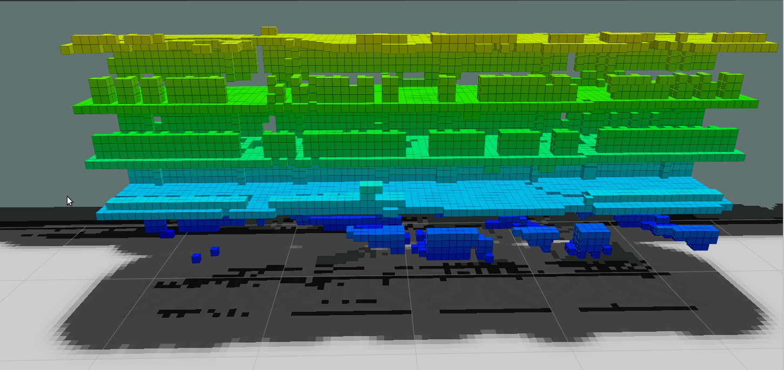
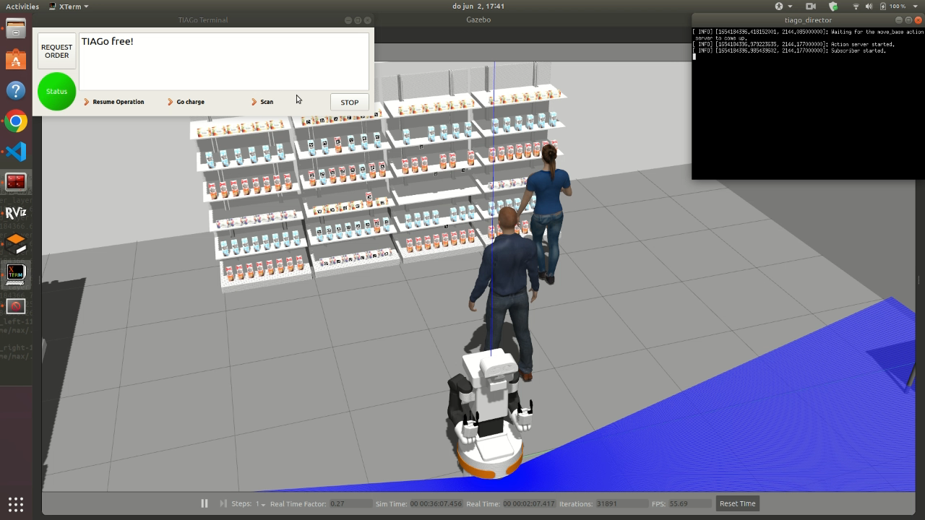
EXTRA! FUTURE WORK
Scanning shelves possibilities:
Relocate misplaced products
Place back products fallen on the floor
Detecting the shelf emptiness for restocking notifications
OctoMap of the shelves in RViz.

Slide 21



Are you ready to hire TIAGo?

Slide 22
Thank you for your attention!
Group 10: Rubén Martín Rodríguez (5507391) Max Polak (4570677) Pim de Ruijter (4580699) Frankie Yuezhe Zhang (5390664) Gioele Buriani (5629888)

Slide 23
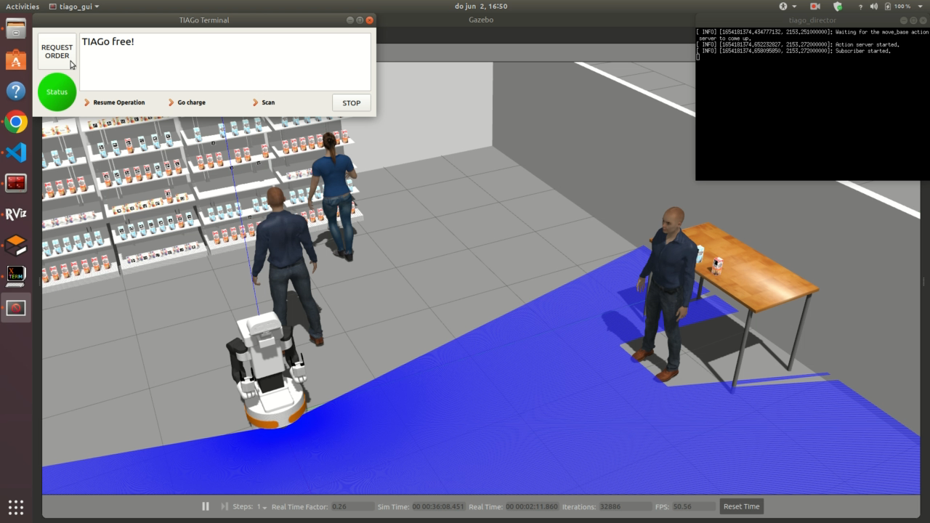
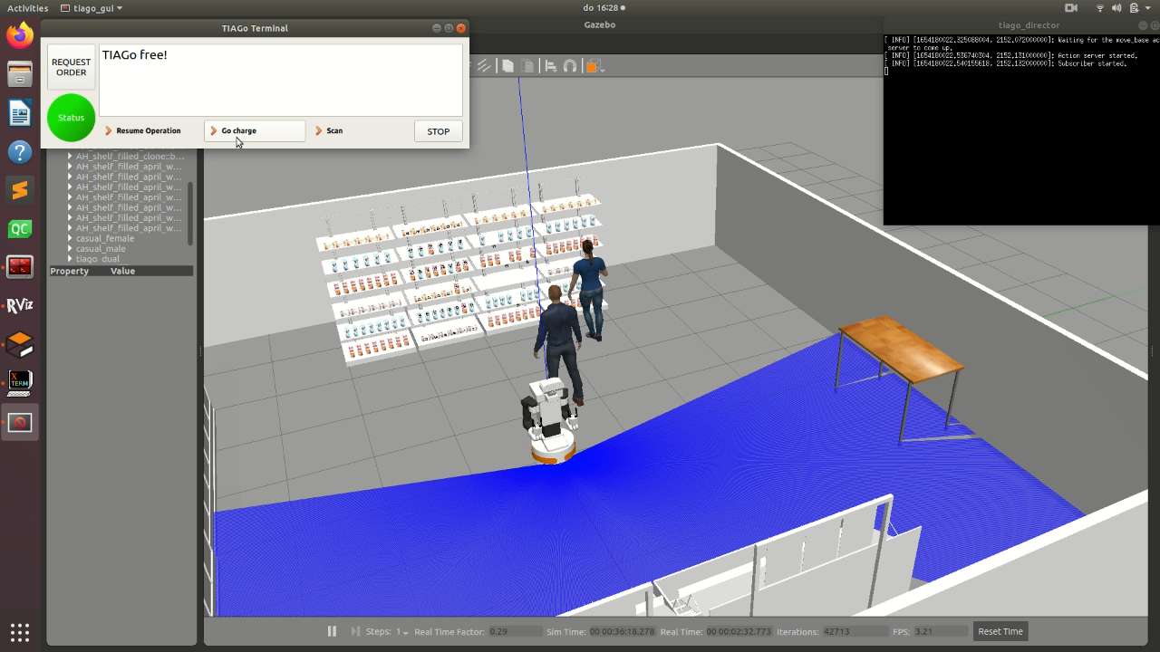
ERROR HANDLING (EXTRA)

Slide 24
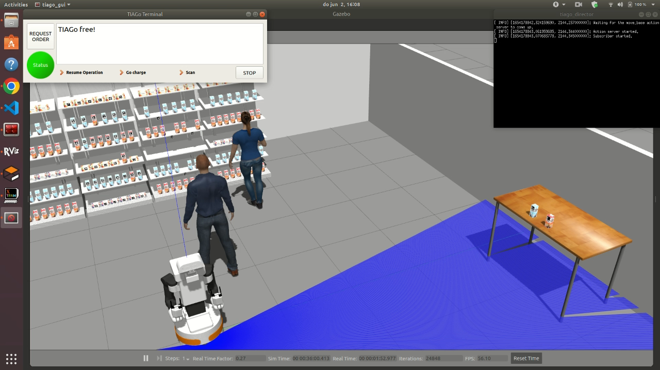
Full Video In Simulation

Slide 25
Full Video In Real World

